Slide 1
生成式AI技術與數位行銷人才養成班
人工智慧概論
謝欽旭
國立高雄科技大學電子工程系
2025

Slide 2
HISTORY OF ARTIFICIAL INTELLIGENCE
Long before Al became a practical possibility, the notion of a “living machine” existed in mythology, particularly in the tales of Ancient Greece and China.
However, the idea was first taken seriously in the 18th century, when engineers created complex, self-propelled devices—or "automata."
Meanwhile, philosophers pondered whether human thought could be simulated by manipulating symbols—an idea that led to the invention of the first programmable digital computers in the 1940s.
By the end of the 1950s, Al was a recognized field of study, and computers have grown more powerful ever since.
This in turn has led to the creation of increasingly versatile Als—although none that can be said to be "alive."

Slide 3

AN IMITATION OF LIFE - AUTOMATA
An automaton is a machine that is able to operate on its own, following a sequence of programmed instructions.
In Al, the word “automaton” refers to a computer that can be programmed to perform a specific task.
The latest Als are highly sophisticated, and appear to have minds of their own.
However, one has yet to be built that can control its own actions (Conscious).

Slide 4
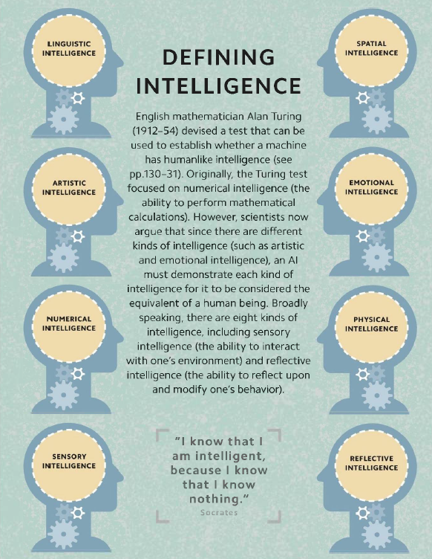
DEFINING INTELLIGENCE - MULTIPLE INTELLIGENCES
Linguistic Intelligence
Spatial Intelligence
Artistic Intelligence
Emotional Intelligence
Numerical Intelligence
Physical Intelligence
Sensory Intelligence
Reflective Intelligence

Slide 5
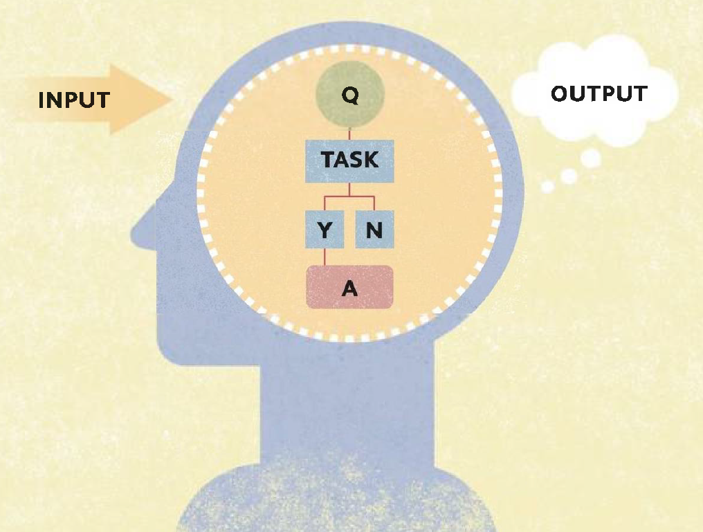
THINKING = COMPUTING - COMPUTATIONALISM
Computationalism: Thinking is a form of computing – A process of using algorithms to convert symbolic inputs into symbolic outputs.
Computationlists argue that the human brain is a computer.

Slide 6
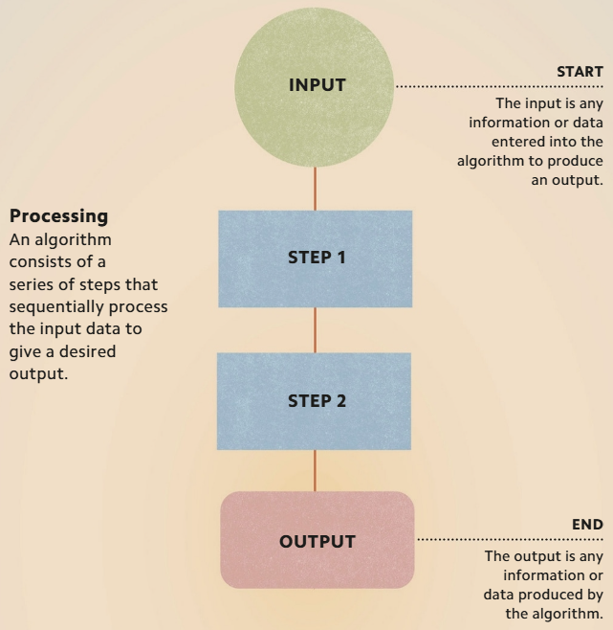
STEP BY STEP - ALGORITHMS
An algorithm is a sequence of instructions for accomplishing a task.
It takes an input, such as information or data, and processes it in a series of steps to produce a desired result, or output.

Slide 7
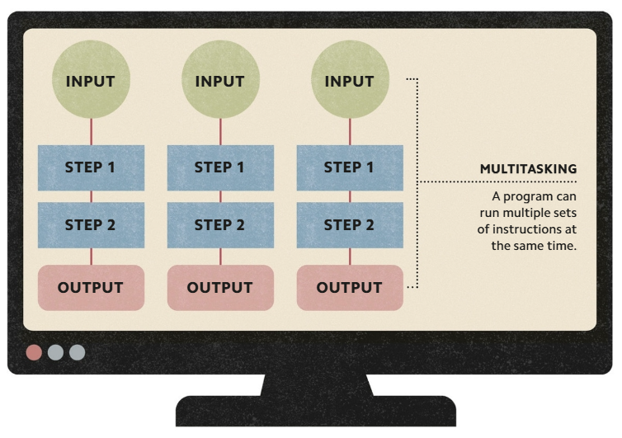
INSTRUCTING COMPUTERS - PROGRAMS
A program is a sequence of instructions written in code that enables a computer to perform one or more tasks.

Slide 8
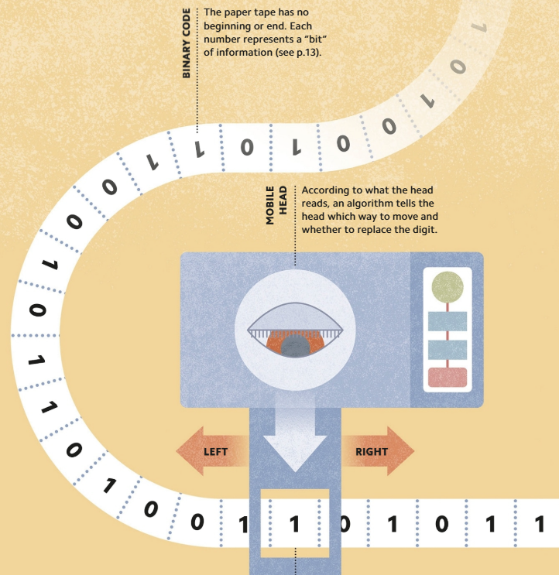
A THEORETICAL COMPUTER - TURING'S UNIVERSAL MACHINE
In 1936, English mathematician Alan Turing (1912-54) proposed an imaginary machine that could solve any problem that could be made "computable.‘’
As long as the problem could be written using symbols and algorithms, and translated into binary code, his machine could solve it.

Slide 9
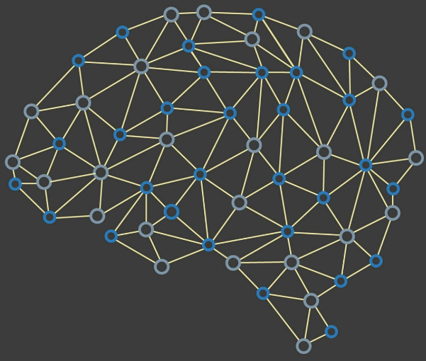
AN ELECTRIC BRAIN - NEURONS AND COMPUTATION
In 1943, scientist Walter McCulloch (1898-1969) and mathematician Walter Pitts (1923-69) demonstrated that networks of units based on human nerve cells, or neurons, passing electric signals back and forth, could copy a Turing machine.

Slide 10
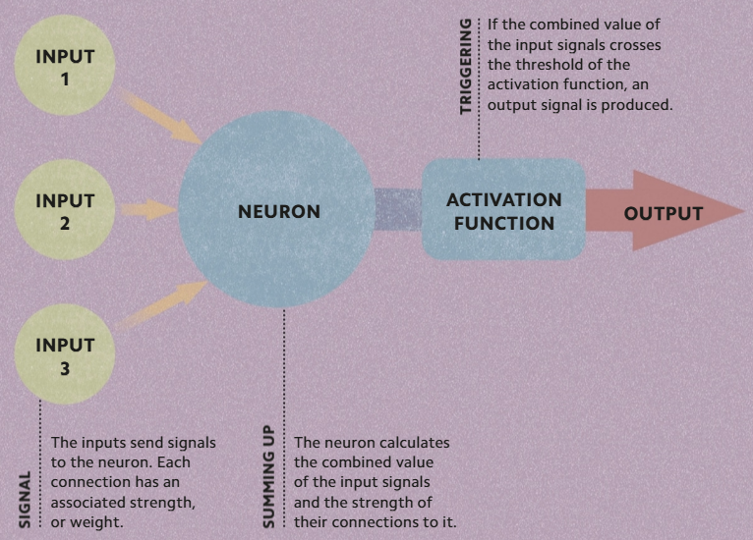
ARTIFICIAL NEURONS - THRESHOLD LOGIC UNITS
Each of the 86 billion neurons in the human brain is effectively a tiny processor, receiving electrical signals (inputs) from other neurons and sending out signals of its own (outputs).
McCulloch and Pitts (see opposite) realized that neurons can act as logic gates—devices that can switch on and off, depending on the input.

Slide 11
A PROGRAMMABLE COMPUTER - ENIAC
The Electronic Numerical Integrator and Computer (ENIAC) was an early electronic computing machine built in the US between 1943 and 1946.
Made up of over 18,000 vacuum tubes (electronic components resembling light bulbs) and covering 1,800sqft (167sqm).
ENIAC was programmed by changing the arrangement of cables that plugged into it.
It was the first machine that could run different programs.

Slide 12
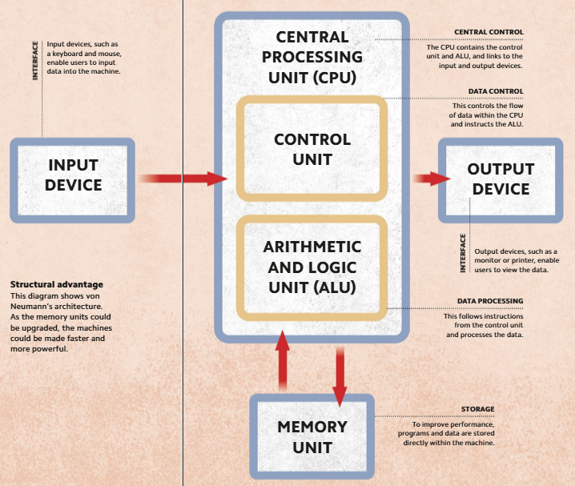
A COMPUTING BLUEPRINT - VON NEUMANN ARCHITECTURE
John von Neumann (1903-57) devised a model that established how the main components of modern-day computers are structured—known as von Neumann architecture.
The major advancement was the use of a memory unit that contained both the programs and data making the machines quicker and easier to reprogram

Slide 13
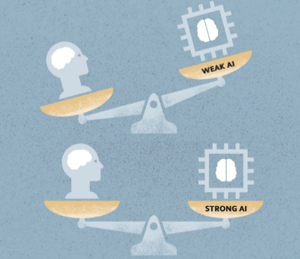
TWO KINDS OF Al - WEAK AND STRONG Al
Some scientists argue that “weak Al” - which includes computers that can do specific limited tasks.
“Strong Al” - an intelligence that can match a human being's in every way.

Slide 14
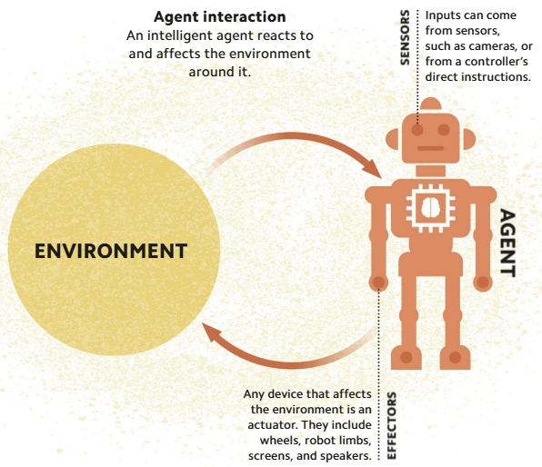
Al IN ACTION - INTELLIGENT AGENTS
An "intelligent agent" in Al is anything that can sense, respond to, and affect its environment - which can be physical or digital.

Slide 15
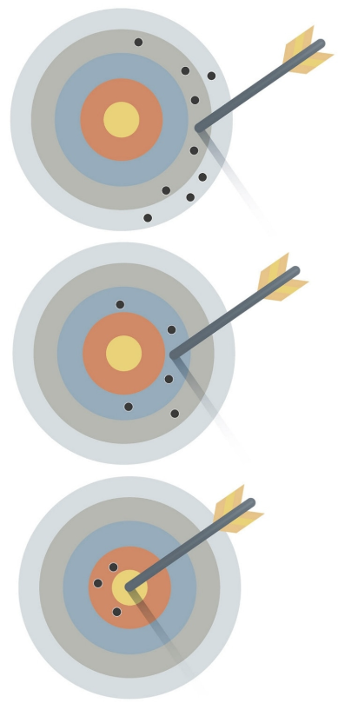
TRIAL AND ERROR - LEARNING TO LEARN
Creating machines that can "learn"—the basis of modern Al—is far more recent and complex.
Programmers use algorithms that are repeatedly revised through trial and error to improve their accuracy.

Slide 16
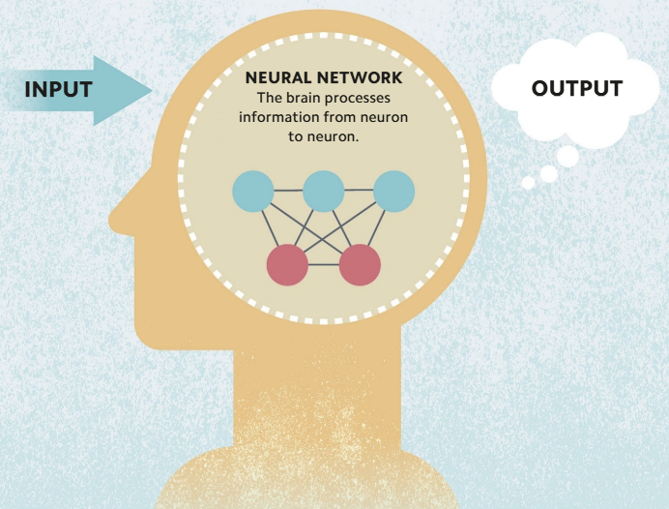
MIMICKING THE BRAIN - CONNECTIONISM
Connectionists believe that intelligence can be achieved by taking simple processing units, such as artificial neurons, and connecting them together into huge "artificial neural networks."

Slide 17
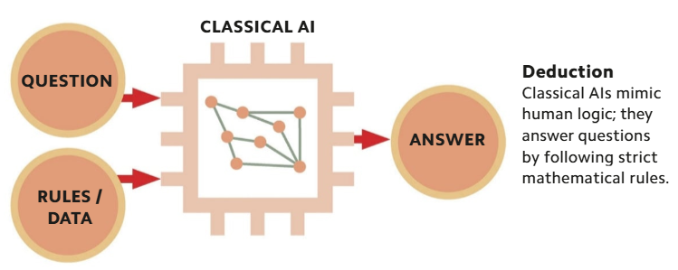
Al MODELS - CLASSICAL VS STATISTICAL Al
The earliest forms of Al are now known as classical (or symbolic) Als.
They were constructed according to the top-down approach, in which computer designers first figured out the rules of symbolic reasoning—how humans think—and built them into the Als.
Their performance was always limited by the rigid application of human-derived rules and their programmers' understanding of them.

Slide 18
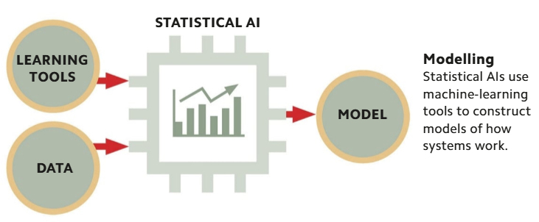
Al MODELS - CLASSICAL VS STATISTICAL Al
In contrast, modern statistical Als are constructed according to the bottom-up approach.
They are provided with masses of data and machine-learning tools that enable them to find patterns in the data.
From these patterns they are able to build models that show how particular systems (such as financial markets) operate under particular conditions.

Slide 19
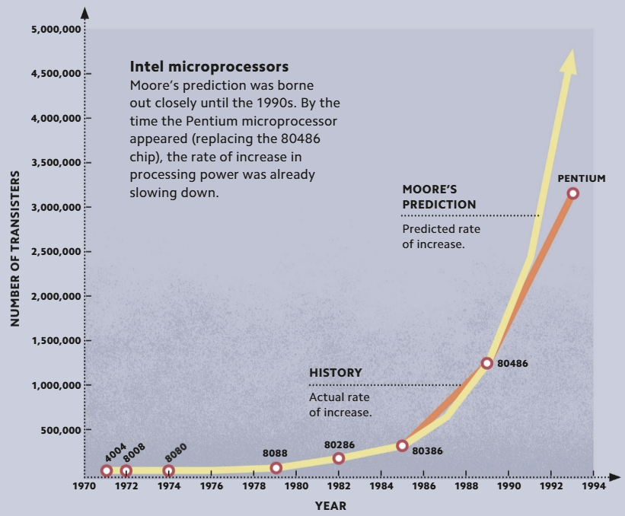
COMPUTING POWER - MOORE'S LAW
Gordon Moore (1929-) predicted that the number of transistors that could be fitted onto a computer chip would double every two years.
Although it has since slowed down, computing power is still increasing each year.
This means that in the foreseeable future, Als will have the same amount of computing power as the human brain.

Slide 20
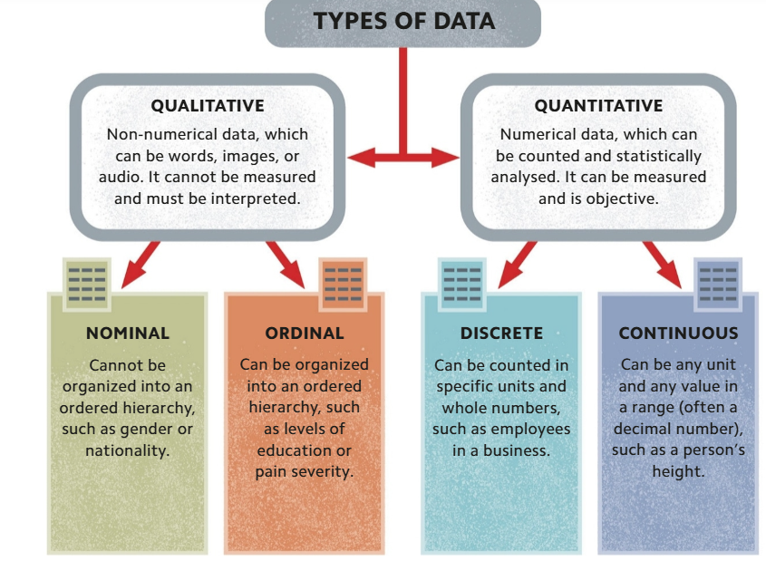
RAW INFORMATION - TYPES OF DATA
Data is information that can take many forms, such as numbers, words, or images.
This data is either "at rest‘’ stored physically in a database), "in transit" (being used for a finite task), or "in use“ (constantly being updated).

Slide 21
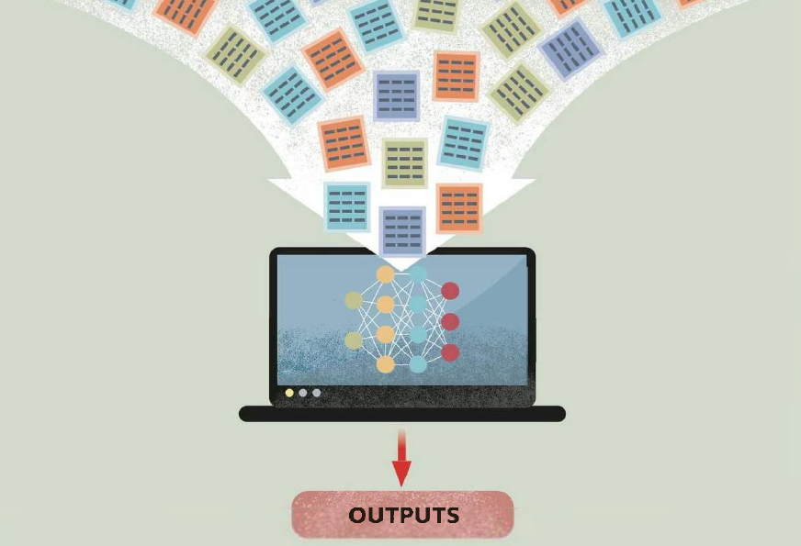
EVERYTHING, EVERYWHERE, ALL OF THE TIME - BIG DATA
"Big data" is a phrase that describes data sets that are too large to be processed by traditional forms of data-processing software.
Big data is widely used in Al, from training machine-learning models, making predictions about the weather or future customer behavior, to protecting against cyberattacks.

